Slide 1
Patricia Parker
EME 6930
Final Project
https://pattyparkerfl.github.io/final/

Slide 2
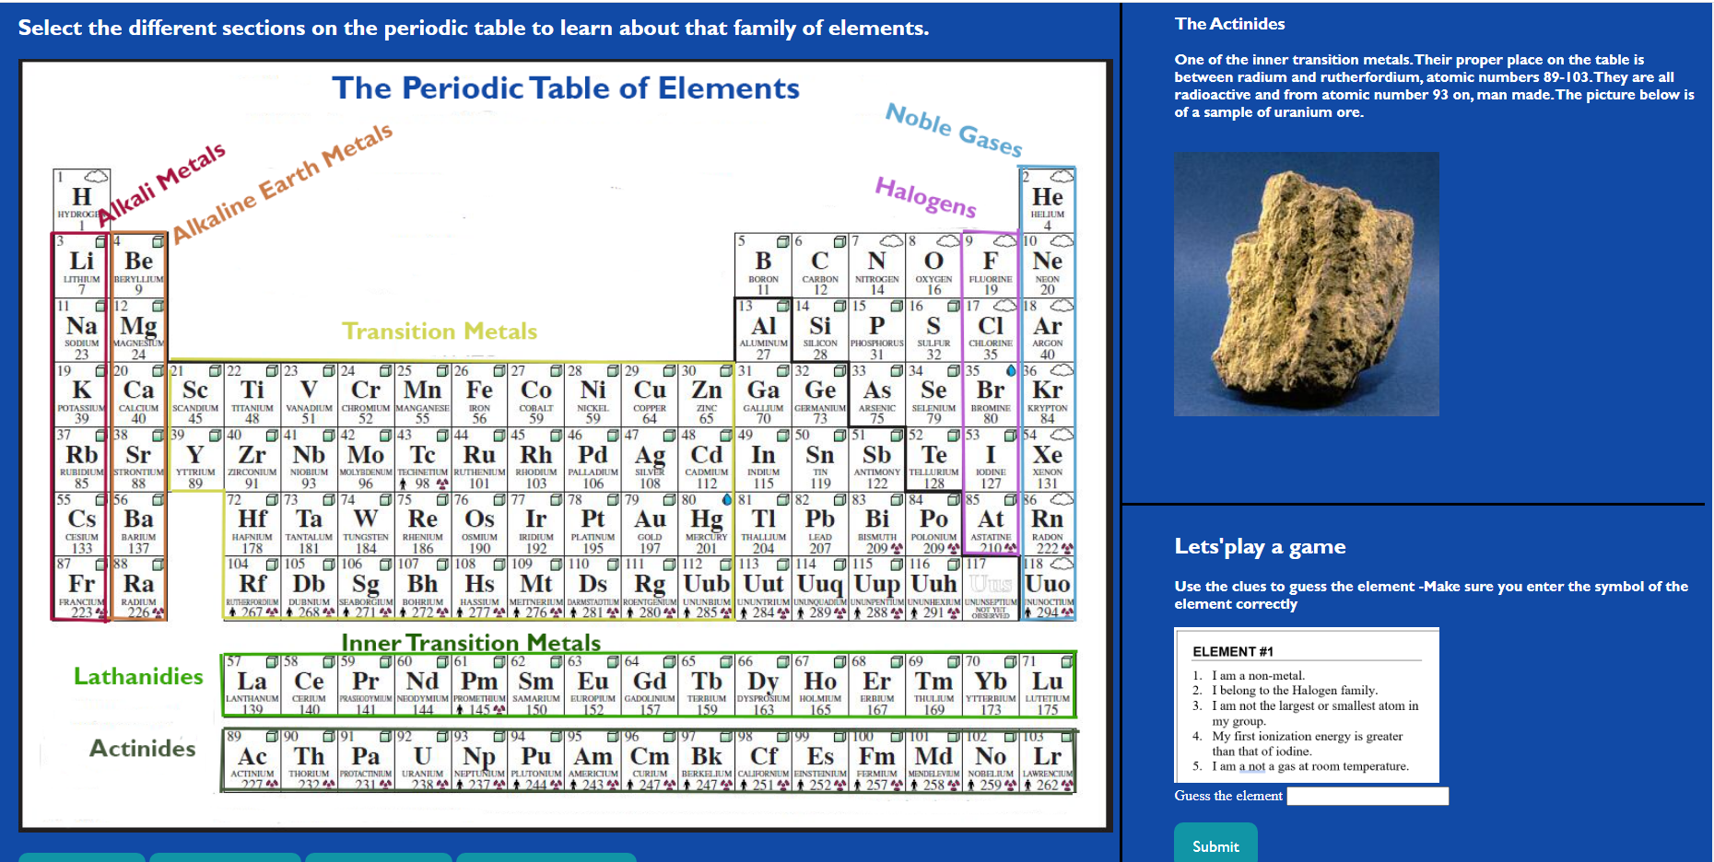
Periodic table interactive lesson
This is a page for High School Chemistry students.
Lesson: They can click parts of the periodic table to learn about the families of the table.

Slide 3
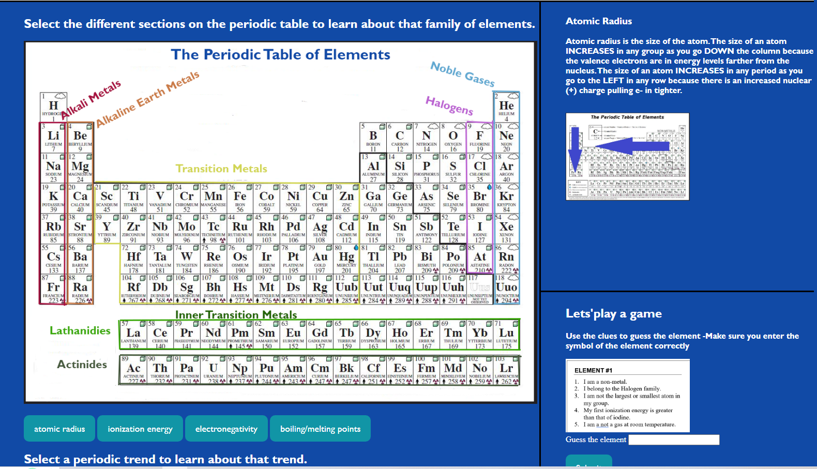
Periodic table interactive lesson
Lesson: There are 4 buttons to display information on periodic trends

Slide 4
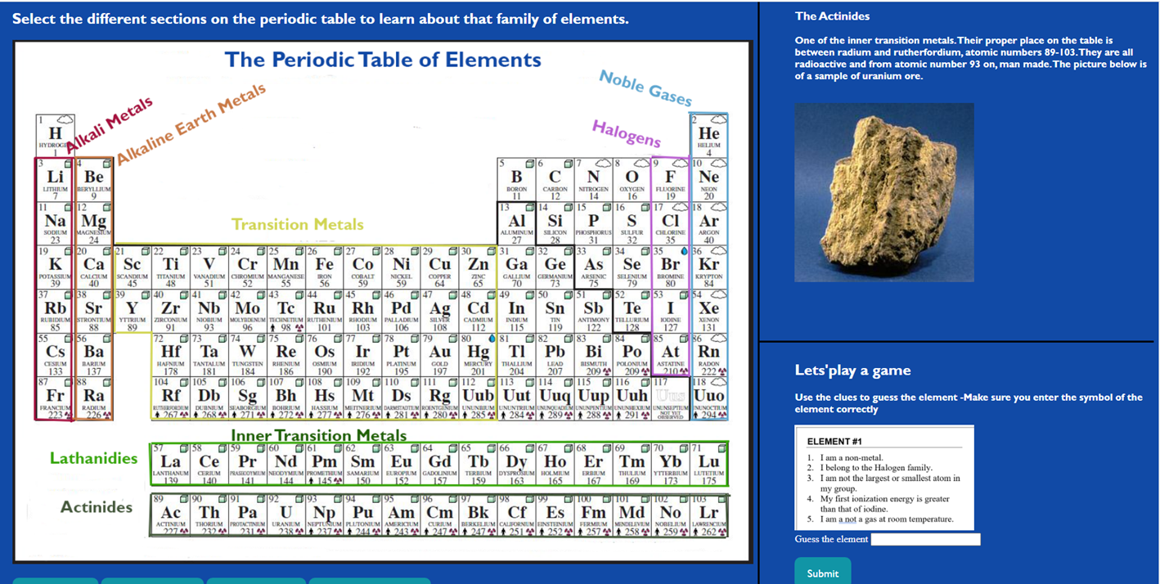
Periodic table interactive lesson
i
Game: Students try to figure out elements based on clues
If they get 2 or more wrong they get hints
Game keeps track of wrong answers

Slide 5
Functions
/*families of the periodic table*/
/*function to display info about alkali metals when user clicks column on periodic table*/
function alkaliLesson() {
document.getElementById("contentHead").innerHTML = "The Alkali Metals";
document.getElementById("content").innerHTML = "Alkali Metals are in group 1/(IA) and are very reactive. They do not exist in nature on their own. Why? All elements in this group have only 1 valence electron and they lose it easily to non-metals. They form +1 cations. Alkali metals are shiny and soft. Like all metals they conduct electricity and are malleable. The picture below is of a sample of sodium.";
document.getElementById('familypic').src="images/sodium.jpg";
}

Slide 6
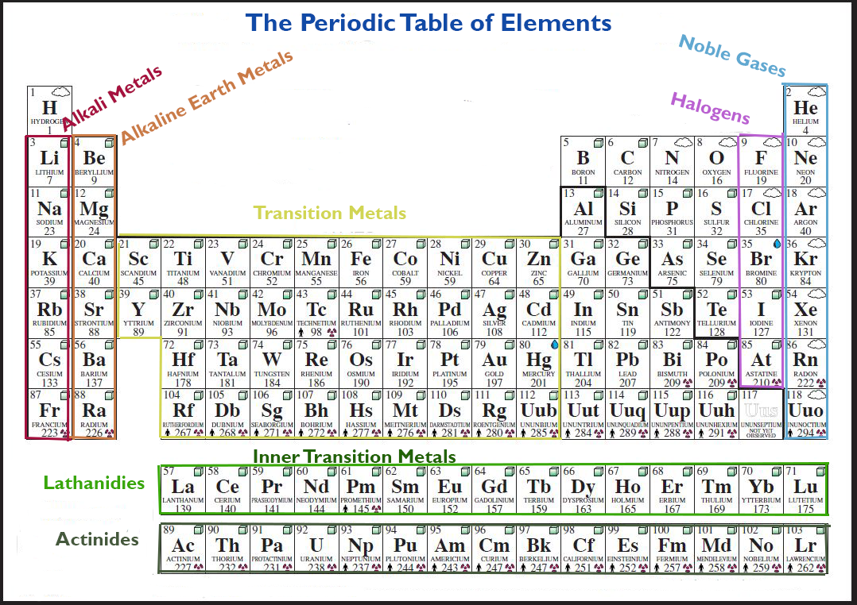
Image map for periodic families
<div class ="pointer">
<map name="familymaptab">
<area shape="rect" coords="20, 140, 70, 425" alt="alklai“ onclick="alkaliLesson()">
<area shape="rect" coords="73, 140, 120, 425" alt="alklaline earth" onclick="earthLesson()">
<area shape="rect" coords="123, 240, 550, 425" alt="transition metals" onclick="transitionLesson()">
<area shape="rect" coords="730, 140, 780, 425" alt="halogens" onclick="halogenLesson()">
<area shape="rect" coords="783, 80, 825, 425" alt="noble gases" onclick="nobleLesson()">
<area shape="rect" coords="150, 460, 825, 500" alt="lanthanides" onclick="lanthanideLesson()">
<area shape="rect" coords="150, 520, 825, 570" alt="actinidess" onclick="actinideLesson()">
</map>
</div>

Slide 7
Functions
/*trends of the periodic table*/
/*function to display content- title, content, and image on button click-atomic radius*/
function displayRadius() {
document.getElementById("contentHead").innerHTML = "Atomic Radius";
document.getElementById("content").innerHTML = "Atomic radius is the size of the atom. The size of an atom INCREASES in any group as you go DOWN the column because the valence electrons are in energy levels farther from the nucleus. The size of an atom INCREASES in any period as you go to the LEFT in any row because there is an increased nuclear (+) charge pulling e- in tighter.";
document.getElementById('familypic').src="images/ptableRadius.jpg";
}

Slide 8
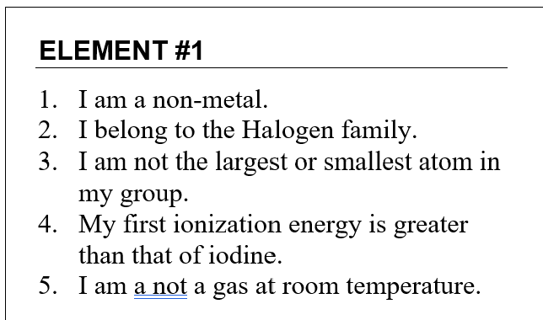
Image array
/*array of game images*/
var imgArray = new Array();
imgArray[0] = new Image();
imgArray[0].src = 'images/element1.png';
imgArray[1] = new Image();
imgArray[1].src = 'images/element2.png';
imgArray[2] = new Image();
imgArray[2].src = 'images/element3.png';
imgArray[3] = new Image();
imgArray[3].src = 'images/element4.png';
imgArray[4] = new Image();
imgArray[4].src = 'images/element5.png';
imgArray[5] = new Image();
imgArray[5].src = 'images/element6.png';

Slide 9
Game code
/*game play, if answer is correct next round begins, if it incorrect they keep guessing until correct and mistakes add up and get displayed*/
var elements =["Br", "Cr", "Sr", "Si", "Sb", "O", "Ne","Pm","Fr","F","Hg","Ca"];
var answer;
var mistakes = 0;
var i = 0;
function playGame (){
var checkAnswer = false;
var newAnswer = document.gameForm.guess.value;
if (newAnswer == elements[i]) {
checkAnswer = true;
i = i +1;
document.getElementById("results").innerHTML = "Grreat job! " + newAnswer+ " is correct. Guess the next element";
document.getElementById("whoami").src = imgArray[i].src; }
else{
mistakes = mistakes + 1;
document.getElementById("results").innerHTML = "Bummer! " + newAnswer + " is incorrect. Try again." ;
document.getElementById("gamestatus").innerHTML = "You have made " + mistakes + " incorrect guesses"; }

Slide 10
Hint code
if(mistakes ==2){
document.getElementById("hint").innerHTML = "Hint: Remember the row is equal to the period number and for main group elements the group number equals the number of valence electrons"; }
if(mistakes ==3){
document.getElementById("hint").innerHTML = "Hint: Ionization energy increases up and to the right"; }
if(mistakes ==4){
document.getElementById("hint").innerHTML = "Hint: Atomic radius increases down and to the left"; }
if(mistakes ==5){
document.getElementById("hint").innerHTML = "Hint: Electronegativity increases up and to the right"; }

